Slide 1

FACE RECOGNITION SYSTEM
Under the guidance of Mr. Mithun Mukherjee
Scientist-D & DIO of NIC, Lakhimpur
PRESENTED BY
Prem Kr Sah-222010007033
Hirak Jyoti Sarmah-222010007021 Sahil Prasad-232050007039 Anupom Paul-232050007008
Barak Valley Engineering College, Nirala
Sribhumi, Assam (788701)
Page 1 of 17

Slide 2
C O N T E N T
INTRODUCTION
PROBLEM DEFINITION
OBJECTIVE
REQUIREMENTS ANALYSIS
APPROACH
IMPLEMENTATION DETAILS
FUTURE WORK
CONCLUSION
REFERENCES

Slide 3
I N T R O D U C T I O N
Face recognition is a popular pattern matching method used to identify individuals based on facial features. It plays a vital role in areas like surveillance, identity verification, and security systems.
Our project automates face recognition from documents, especially PDFs containing faces and voter IDs. Manual matching is slow and error-prone, so we use deep learning to extract faces and link them with nearby electors’ image with respective voter IDs (EPIC) for accurate and efficient verification against a stored dataset.

Slide 4
P R O B L E M D E F I N I T I O N
Manual Verification is Slow: Officials spend hours matching faces with IDs from voter lists.
Risk of Duplicate Entries: No easy way to detect if the same person is listed multiple times with slight changes.
Voter Fraud: Fake IDs or impersonation may go undetected due to lack of automated face matching.
Human Error: Mistakes in matching faces to correct voter IDs can lead to incorrect verifications.

Slide 5

OBJECTIVE
Enhance Transparency: Ensures that official records are validated with high accuracy, increasing public trust.
Improve Data Integrity: Maintains a clean, duplicate-free database of verified citizens or voters.
SECURE
Prevent Voter Fraud: Detects duplicate faces and mismatched IDs, reducing impersonation or multiple voting.
Reduce Human Error: Minimizes mistakes caused by manual checking of documents.
AUTOMATED

Slide 6
REQUIREMENTS ANALYSIS
FUNCTIONAL REQUIREMENTS | NON-FUNCTIONAL REQUIREMENTS
Face Detection: Extract faces from uploaded PDFs. | Performance: Fast processing of images and PDFs.
ID Extraction: Detect and link nearby voter ID to each face. | Accuracy: Correct face-ID pairing and match results.
Matching: Compare extracted faces with saved dataset using similarity. | Usability: Easy-to-use interface for all users.
Data Upload: Allow admins to add new face entries with voter IDs. | Scalability: Can handle many faces and large documents.
User Interface: Simple upload and result view through web app. | Portability: Runs on any system with Python support.
Page 6 of 17

Slide 7



DATA FLOW DIAGRAM
Extract and Match
Upload pdf/ image
Face Recogn. System
Admin
Result
Fig 1 : Zero Level DFD
Page 7 of 17

Slide 8
APPROACH
PDF Parsing: Extracted Voter ID images from uploaded PDF using PyMuPDF.
Face Detection: Used InsightFace to detect and crop faces from each image.
Feature Extraction: Generated face embeddings for accurate
identification.
Voter ID Extraction: Applied regex to extract Voter ID numbers from text.
Mapping: Matched each face with the correct Voter ID using order and embeddings.
Result Display: Displayed and stored the final mapped results.

Slide 9


APPROACH (Development & Deployment)
Frontend development for voters and admin
Integration and testing using Flask and localhost

Slide 10
IMPLEMENTATION DETAILS
Built with Flask for web-based PDF upload and processing.
Used PyMuPDF to extract images and text from voter list PDFs.
Applied InsightFace for face detection and embedding.
Extracted Voter IDs using regular expressions from nearby text.
Matched faces using cosine similarity and displayed matched results with ID and accuracy.
Voter IDs saved in a CSV file; unmatched faces stored in a separate folder.

Slide 11
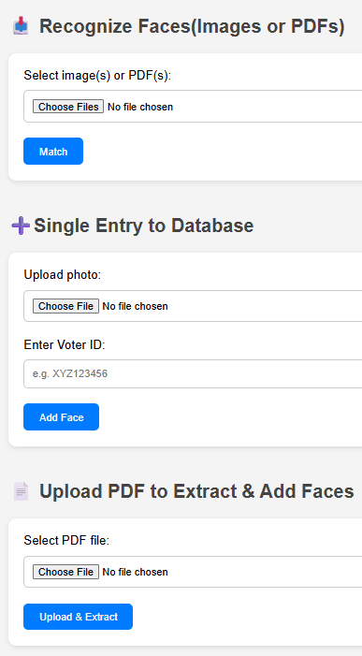
PROJECT SNAPSHOTS
Upload images/PDFs to detect faces and display matched Voter IDs with accuracy.
Upload a photo and assign a Voter ID to add a new entry.
Interface
Upload a PDF to extract and store faces with Voter IDs.
Page 11 of 17

Slide 12
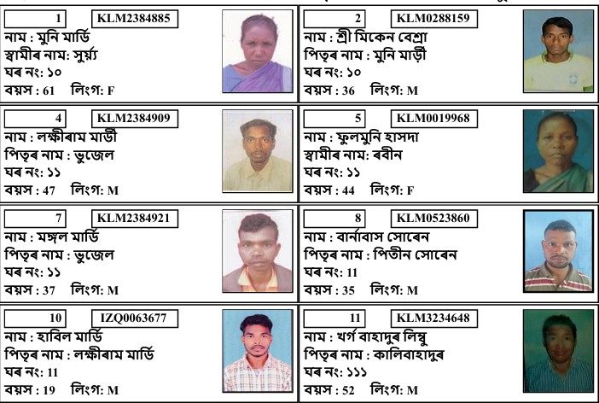
Input Pdf Format
Page 12 of 17

Slide 13
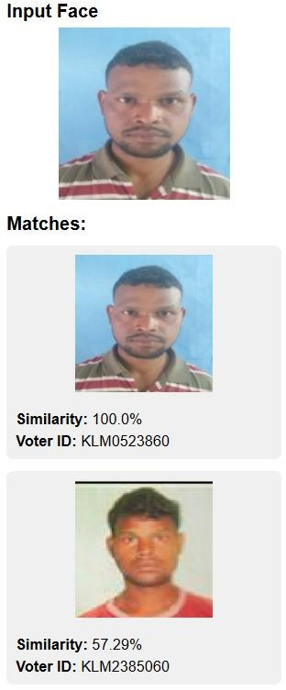
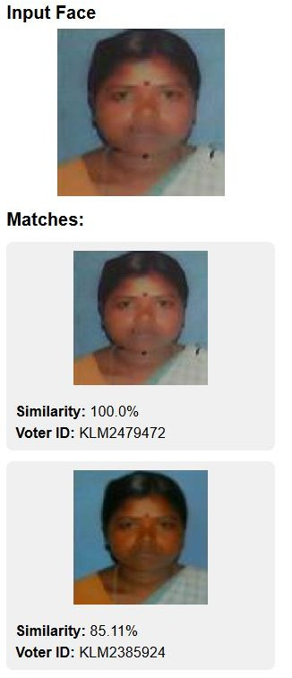
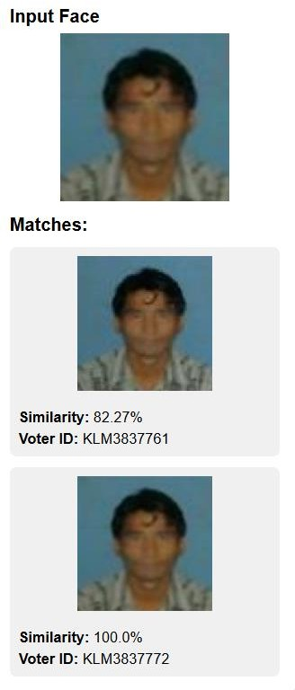
PROJECT SNAPSHOTS
High Matching Faces With Different Voter IDs
Same Faces with
Different Voter IDs
Fig: Output Image
Page 13 of 17

Slide 14
FUTURE WORK
Integrate database (SQLite/MySQL/PostgreSQL) instead of CSV for better storage and security.
Improve text detection using Tesseract OCR for voter ID accuracy.
Improve Time and Space Complexity.

Slide 15
CONCLUSION
Successfully built a functional face recognition system for documents.
Automated extraction of faces and voter IDs improves speed and accuracy.
Can be used in electoral processes, surveys, or ID verification.
Provides a complete pipeline from input to match result.

Slide 16
REFERENCES
GeeksforGeeks: – bit.ly/3IHsIEV
PyMuPDF (fitz): – http://bit.ly/45iKHdz
Medium: Facial Analysis with InsightFace – http://bit.ly/40yRUUa

Slide 17
Thank you!

